Slide 1

Université Libanaise Faculté de sciences économiques et de gestion Branche 3
News Advance
AI-Powered News Analysis
prepared by:
Nacir Chahine
Jury:
Dr. Dalia Batikh
Dr. Mohammad Shok
Dr. Abdul Rahman El Sayed
2024/2025
Notes:
Ok 5allina de8reh nballesh lakan
Tab3an ma3kon Nacir Chahine
Ahla w sahla bel Dr. Nader wa Dr. Fadi…
W metel manu wade7 7a nkoun 3m ne7ki lyom 3n l scraping…

Slide 2
CONTENTS
01
04
Introduction
Implementation
02
Platform and Tools
05
Technical difficulties
03
UML diagrams
06
Class diagram
Use Case
Perspective
Notes:
Fa our presentation 7a tkoun fiya hal fakarat…
1- mukaddimeh 3anwaht is scraping w shu l hadaf mn our project
2- al minassat wal 2adawat li ista5damnehon
3- rusum bayeniyeh
4- Tatbik – w akid 7a ykun fi live Demo
5- l su3ubet li wejahta bel tari2..
6- shu fina nzid aw what can we improve bi hal project, w wen mumken yusal bel next versions
Bidun ay te25ir 5alluna nballesh bel introduction

Slide 3
INTRODUCTION
A web application to analyze and summarize news articles
Helps users identify bias, sentiment, fallacies, and misinformation
Combines traditional NLP with AI models
‹#›
Notes:
So l hadaf l ra2isi mn hal project huwe:
Tejmi3 w tenzim l ma3lumet tab3u l companies, la 2este5demon ba3den bi shakel mrattab w bel teli ahyan lal user (li bi hal 7aleh henne marketing aw sales team)
W metel ma kellna mna3ref wa7deh mn aham l 2mur li bet2addi la naje7 our marketing or sales team is to have some good data ben 2idayon 3an hal sector li 3am yestahedfu
W la hal shi 7a nesta3mel the scrapping method as a solution

Slide 4
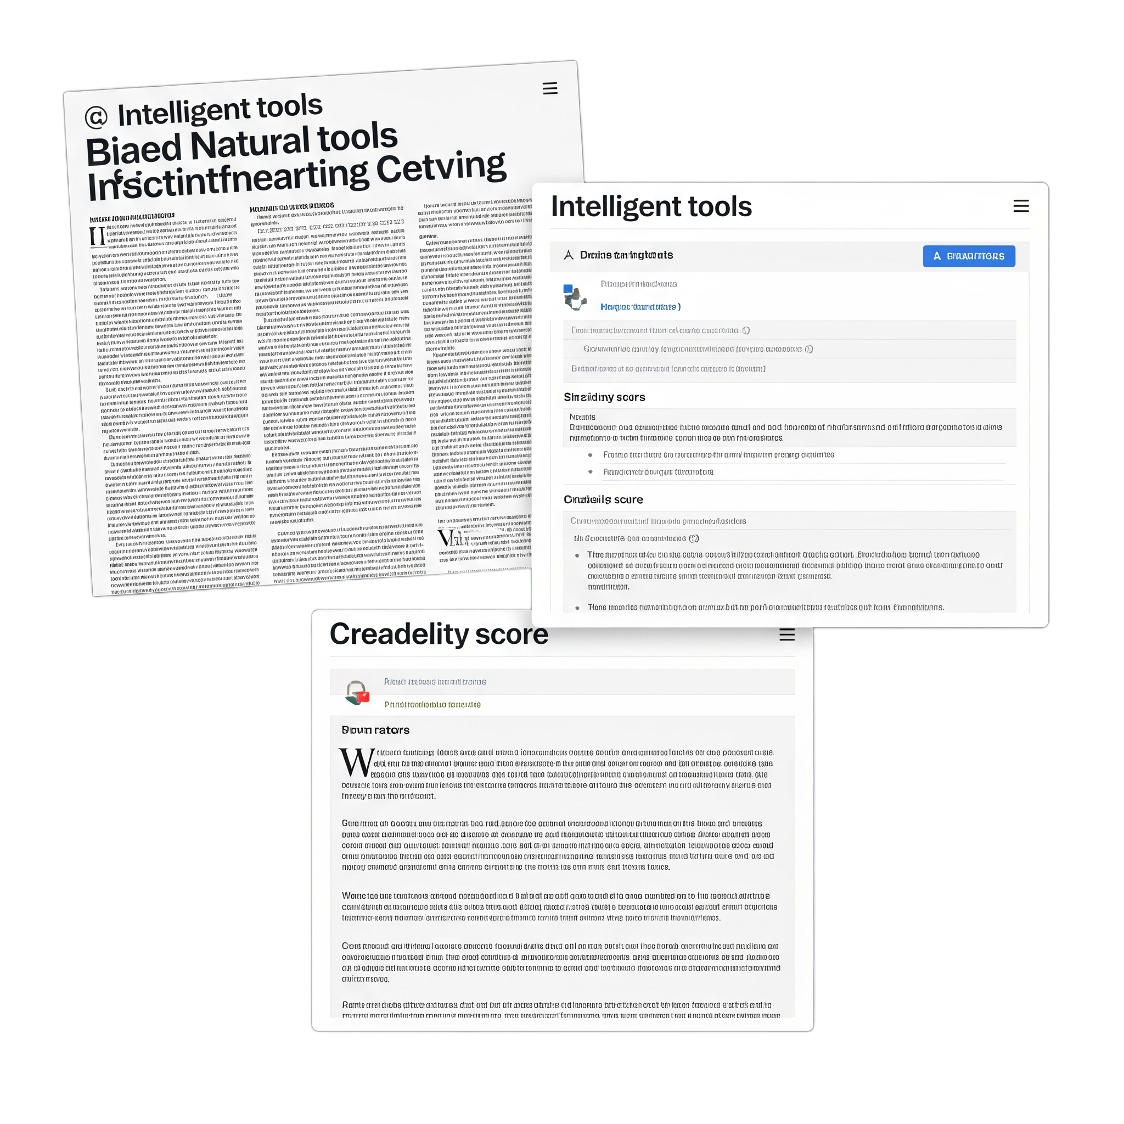
INTRODUCTION
Problem Statement
Digital media is saturated with biased or misleading news
Users struggle to assess the credibility of articles
Need for intelligent tools that analyze news content
Notes:
So shu hiyeh l webscraping
Web scrapping huweh iste5raj content aw data from a website using bots.
Li bi dawron bye5du the page’s data ta7didan mn l HTML code aw 7atta mn l data base…
Ba3den the scraper can reproduce the entire website's content elsewhere,
like organize it in the database.
Kell haydol l extracted data can be very helpful lal este3mel by any team that needs information and contacts of companies in any specific sector.

Slide 5
PLATFORM AND TOOLS USED
Notes:
al minassat wal 2adawat li ista5damnehon

Slide 6





PyCharm
Python
HTML5, CSS3, JS
jQuery, bootstrap
IDE
Programing Language
for back-end
Programing Languages
for front-end
Notes:
Spyder: Spyder is an open-source cross-platform integrated development environment for scientific programming in the Python language
PyCharm: PyCharm is a dedicated Python Integrated Development Environment (IDE) providing a wide range of essential tools for Python developers, tightly integrated to create a convenient environment for productive Python, web, and data science development
Python: is our Programing language of choice | so any code written in spyder or PyCharm 7a ykun bi lu8et l python

Slide 7






DJANGO
SQLite (dev), PostgreSQL (prod)
NLTK, spaCy, Transformers, Ollama
PYTHON FRAMEWORK
Data base
AI/NLP
Notes:
Django: is our Python Framework off choice | shi metel flask iza ken more familiar lal ba3d
SQLite: huweh l data base li 5terneh.. Lesh la2an huweh l 5iyar l afdal lal small project
Postman: sta3malneh for testing our APIs

Slide 8
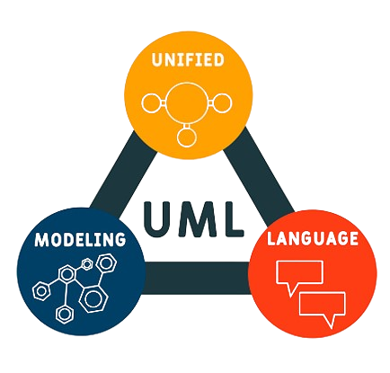
UML DIAGRAMS
Class Diagram | Use Case

Slide 9
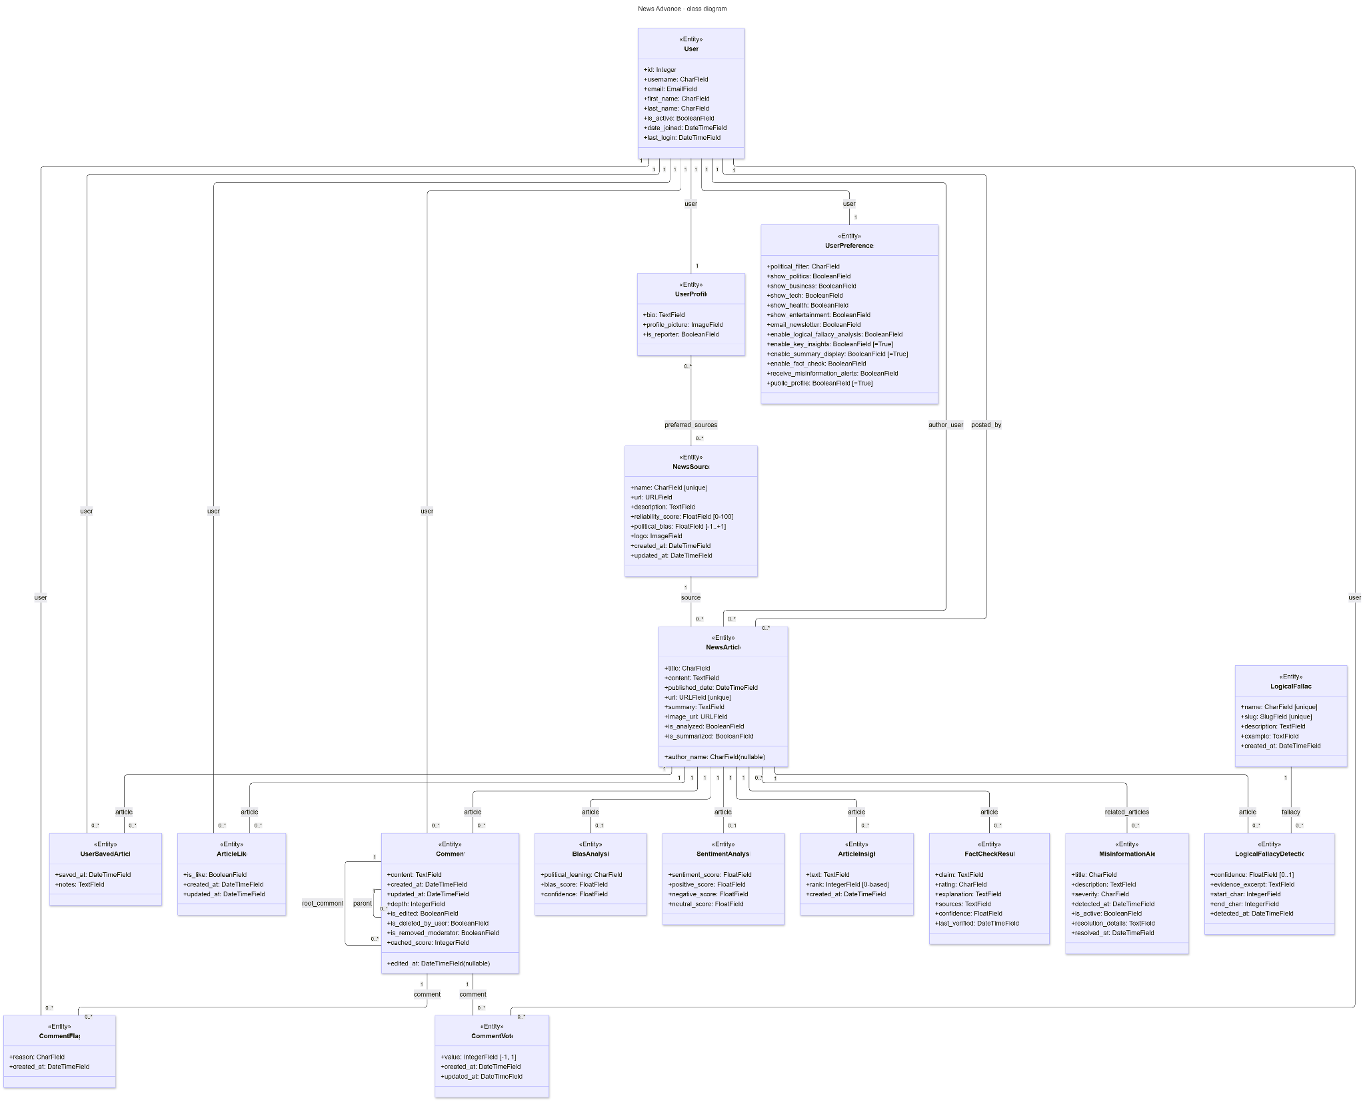
CLASS DIAGRAM

Slide 10
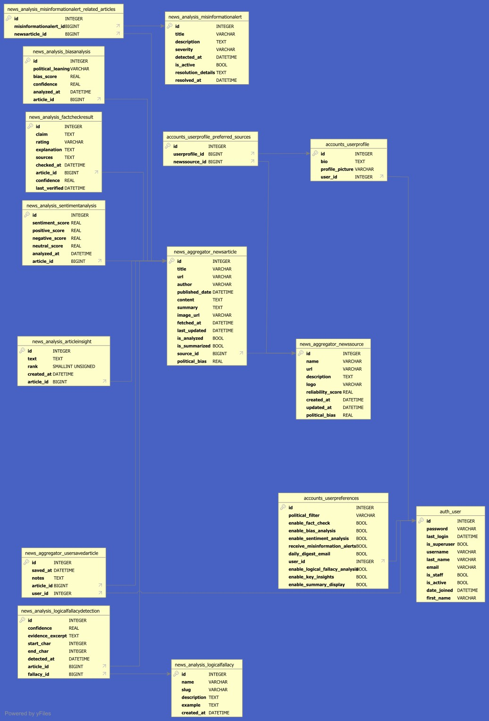
DATABASE TABLES

Slide 11
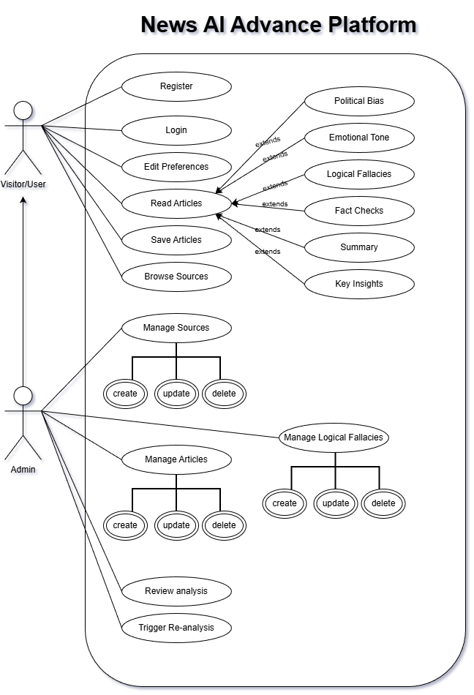
USE CASE

Slide 12
IMPLEMENTATION
Notes:
Tatbik

Slide 13
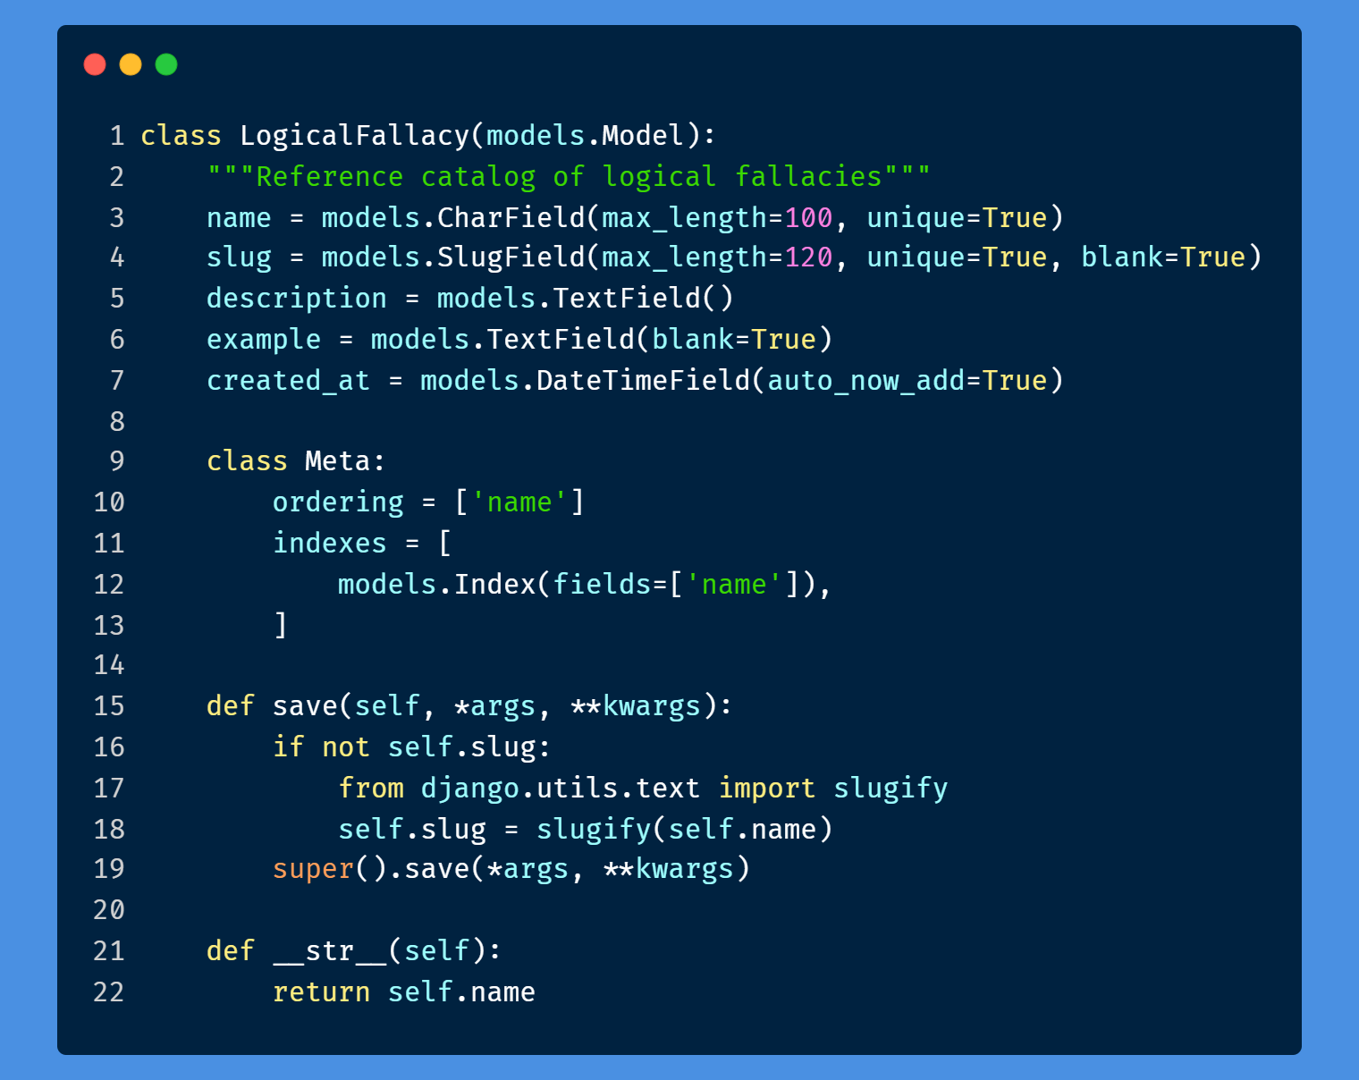
MODEL-VIEW-TEMPLATE (MVT)
Model
is an object in the Django application that specifies the data structure.

Slide 14
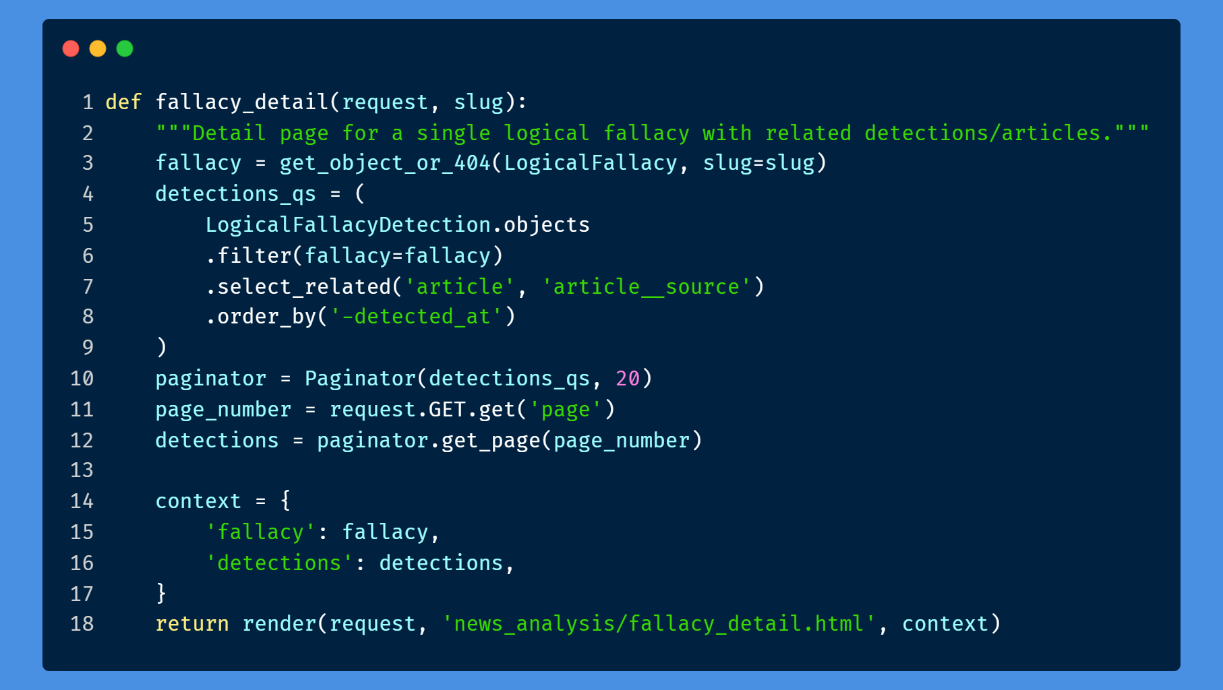
MODEL-VIEW-TEMPLATE (MVT)
VIEW
is an HTTP handler function that receives HTTP requests, handles them, and then returns the HTTP response.

Slide 15
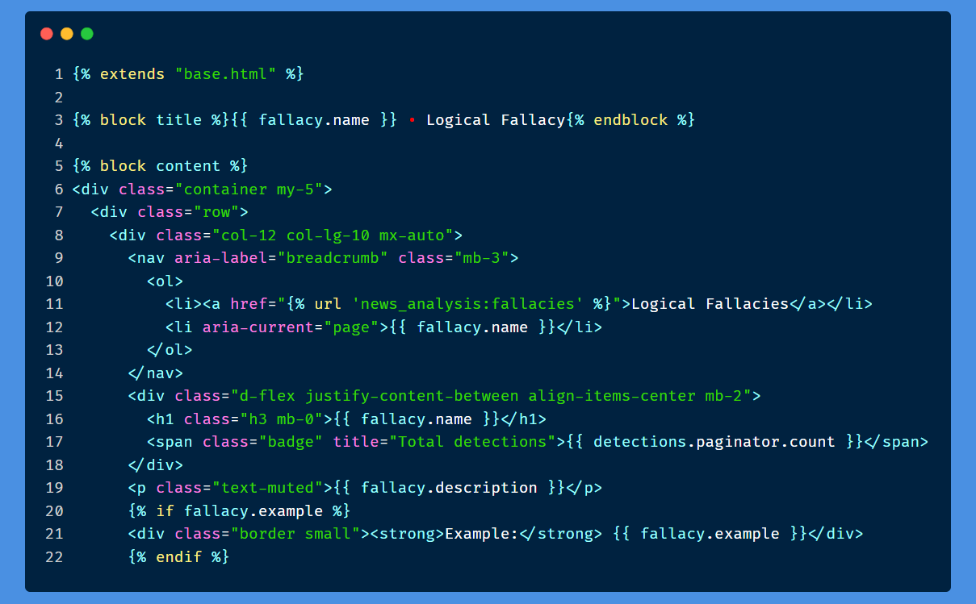
MODEL-VIEW-TEMPLATE (MVT)
Template
defines the user interface layout or structure. can be HTML, XML, etc.
It can receive data from the view and render it with jinja syntax.

Slide 16
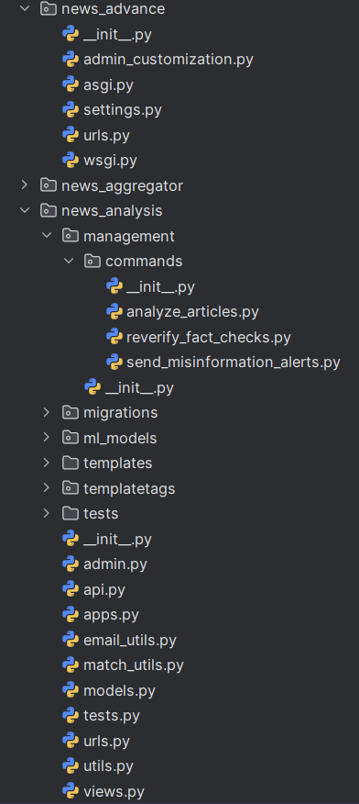
OTHER IMPORTANT .PY FILES
SETTINGS.PY
Where we can edit all our project settings,like (database, application connections etc.)
URLS.PY
To create routes in the project. like: /admin /about etc.
ADMIN.PY
Here we register our already created models
To display your models in the Django admin panel. You can also customize your admin panel
Notes:
URLs where all routing magic happens

Slide 17
OTHER IMPORTANT .PY FILES
COMMANDS
Here lives the functions that will be executed when we run out custom cmd command and its custom flags, like
python manage.py analyze_articles --article_id 123
MATCH_UTILS.PY
This file contains some reusable functions to be used across the application.
Notes:
URLs where all routing magic happens

Slide 18
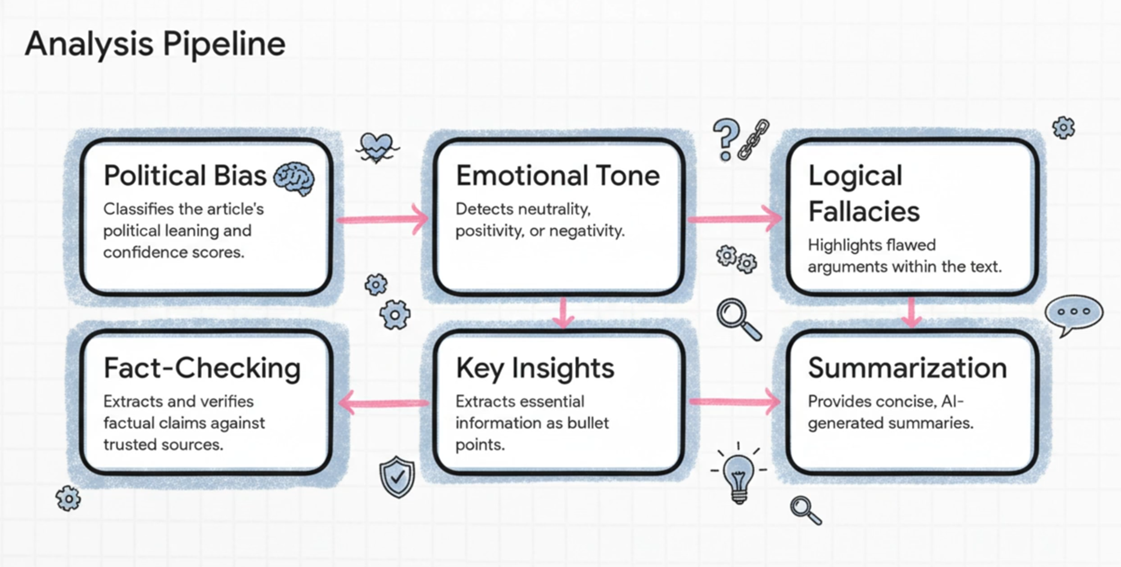
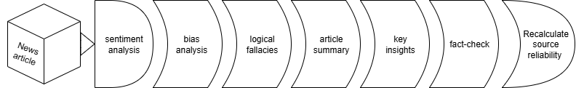
Article analyse pipeline
Notes:
URLs where all routing magic happens

Slide 19
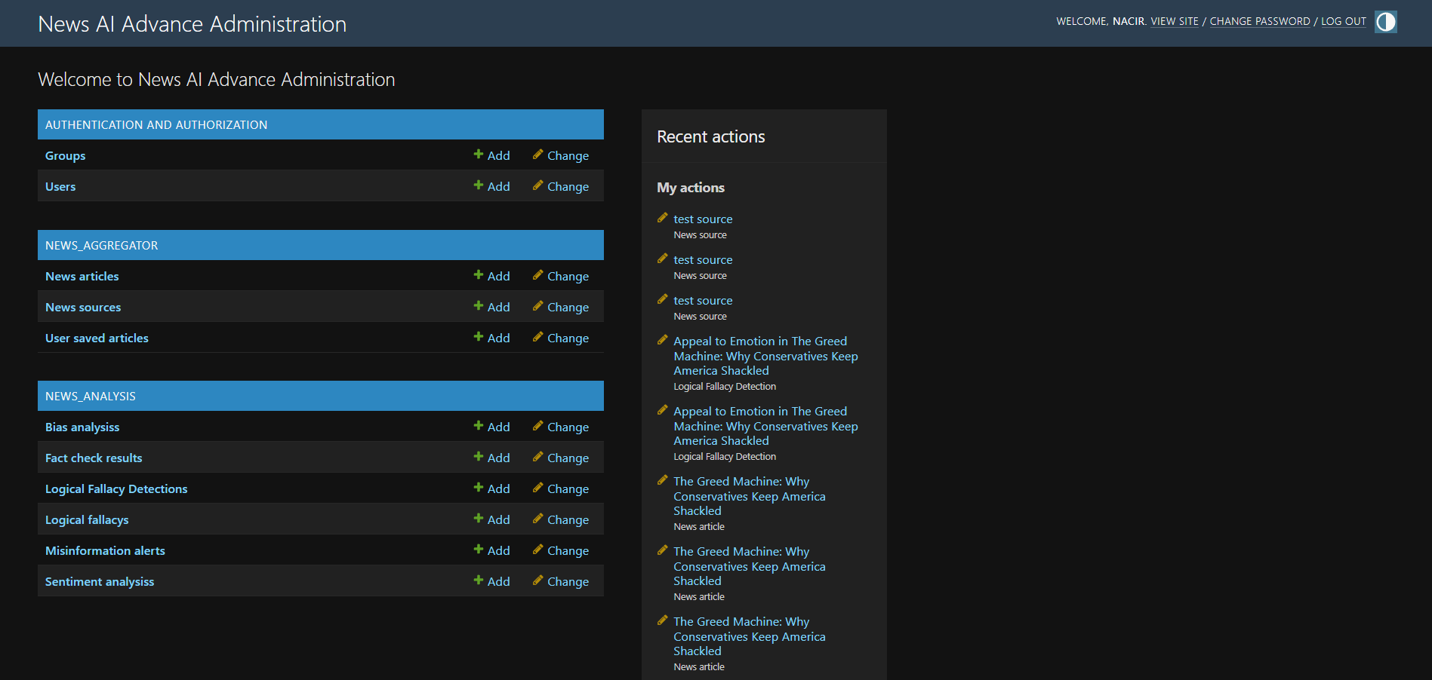
BACKEND DASHBOARD

Slide 20
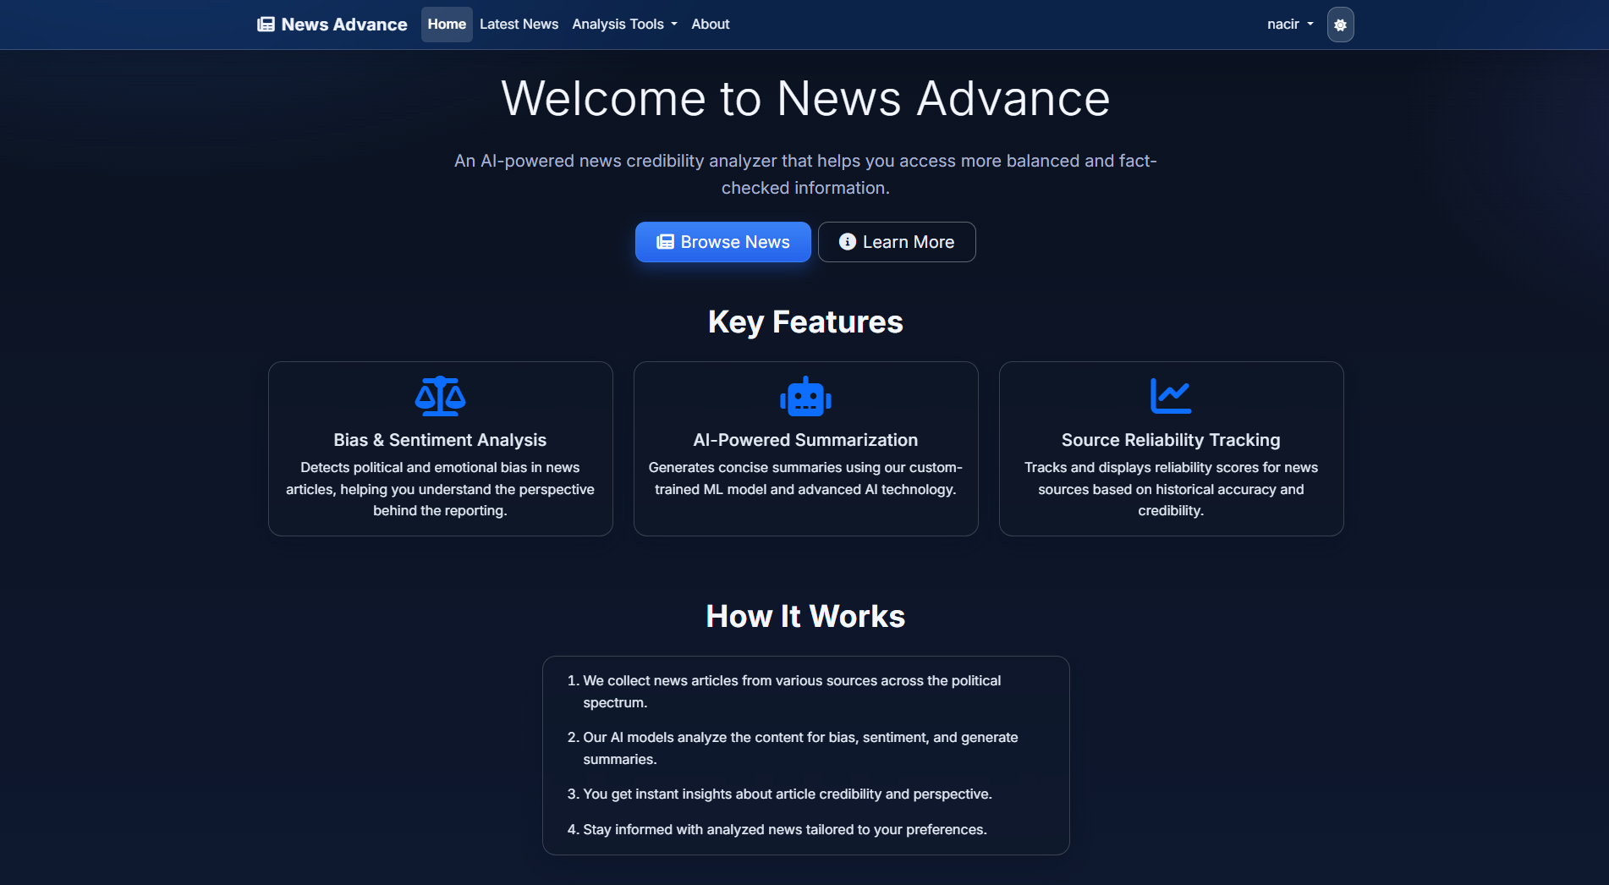
FRONTEND
INTERFACE

Slide 21
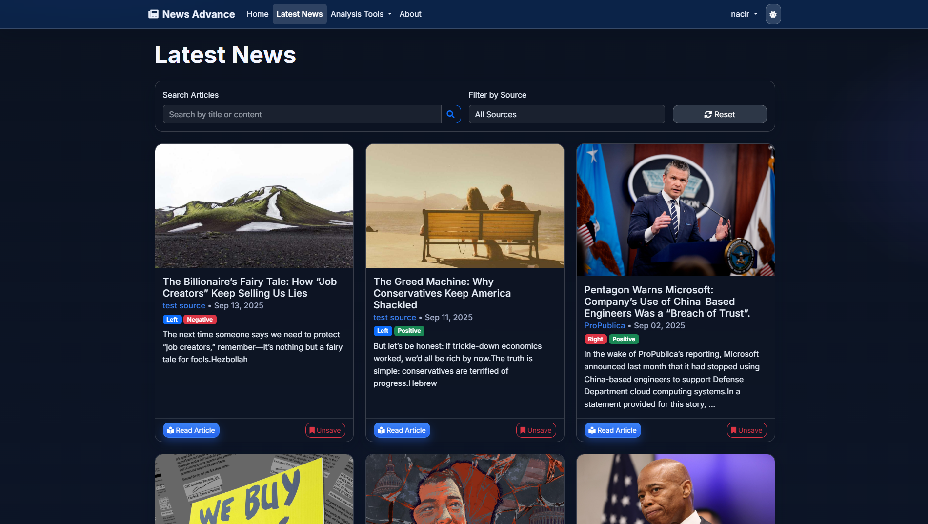
FRONTEND
INTERFACE

Slide 22
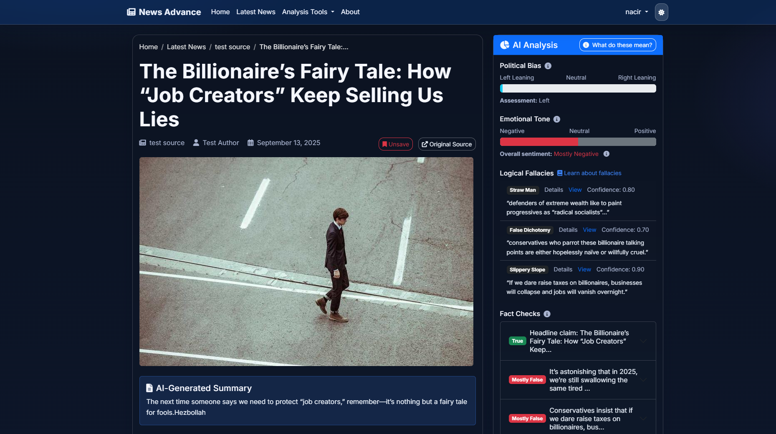
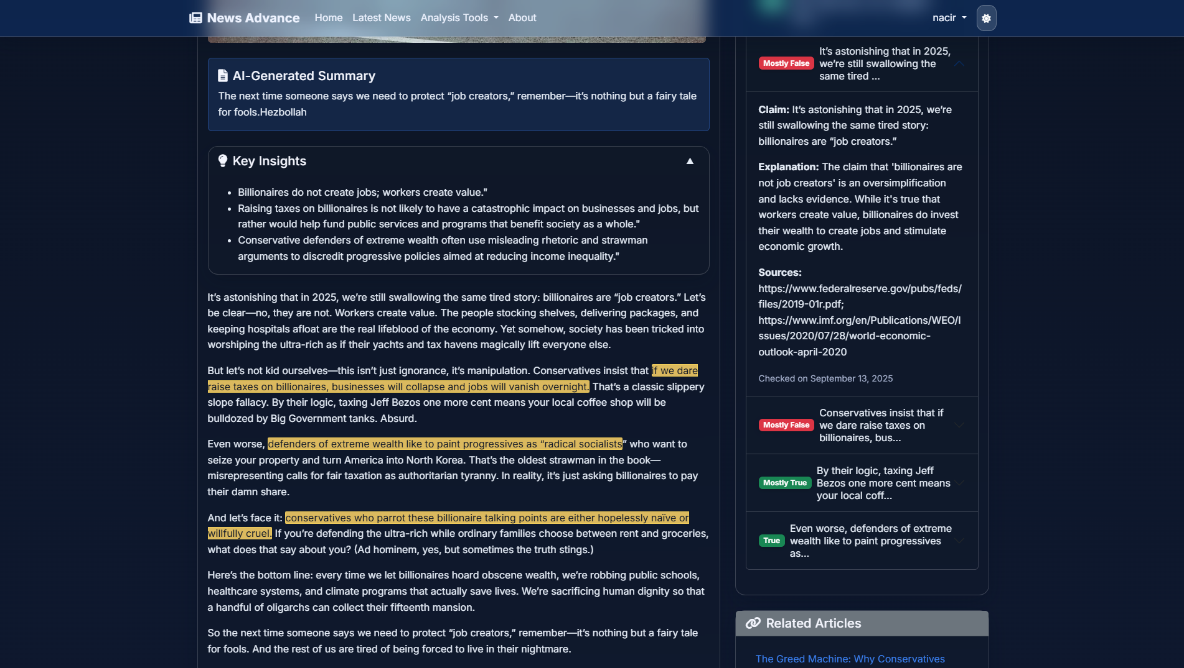
FRONTEND
INTERFACE

Slide 23
DEMO

Slide 24
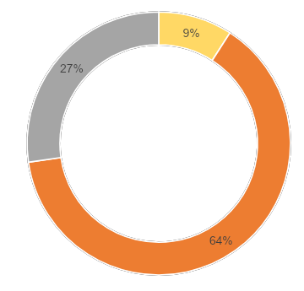
TECHNICAL DIFFICULTIES
9%
the configuration and installation of the environments
27%
Gathering the necessary information of what a real news reader can benefit of
64%
Learning new programming language and a new framework that has become widely available and important for a lot of small and scalable projects. And leaning to build and use LLM.

Slide 25
PERSPECTIVE

Slide 26
PERSPECTIVE
API Development
Mobile version (Application) with full API integration.
Real-time Misinformation Detection
Expert Review Process

Slide 27
THANK YOU
Nacir Chahine
+961 70 285656
chahinnacir@gmail.com
nassir.bio.link
Jury:
Dr. Dalia Batikh
Dr. Mohammad Shok
Dr. Abdul Rahman El Sayed

